Slide 1

Bounding
John Nganga

Slide 2
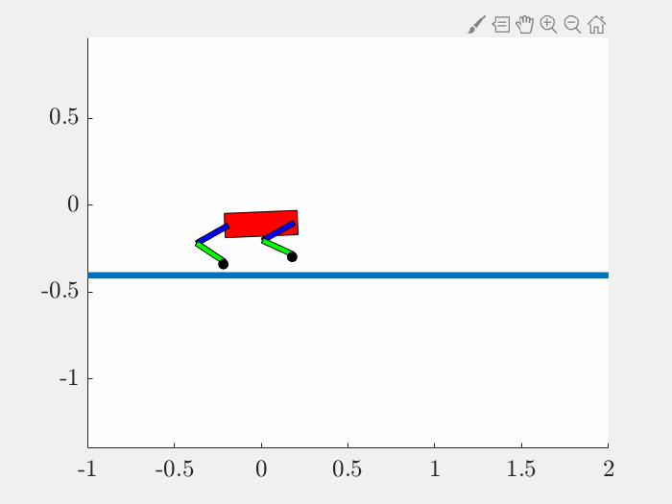
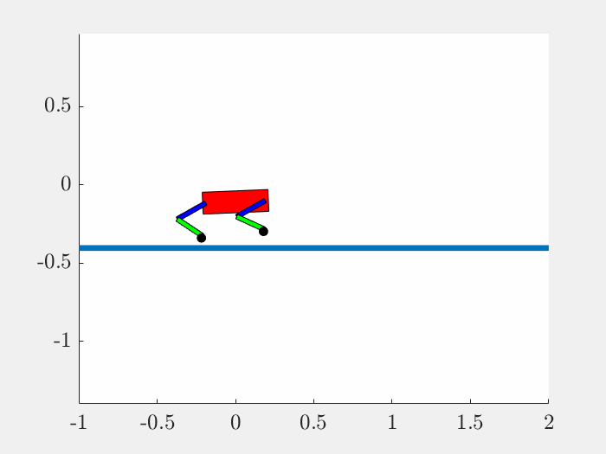
Motion
iLQR
DDP
Bounding with vx = 0.5

Slide 3
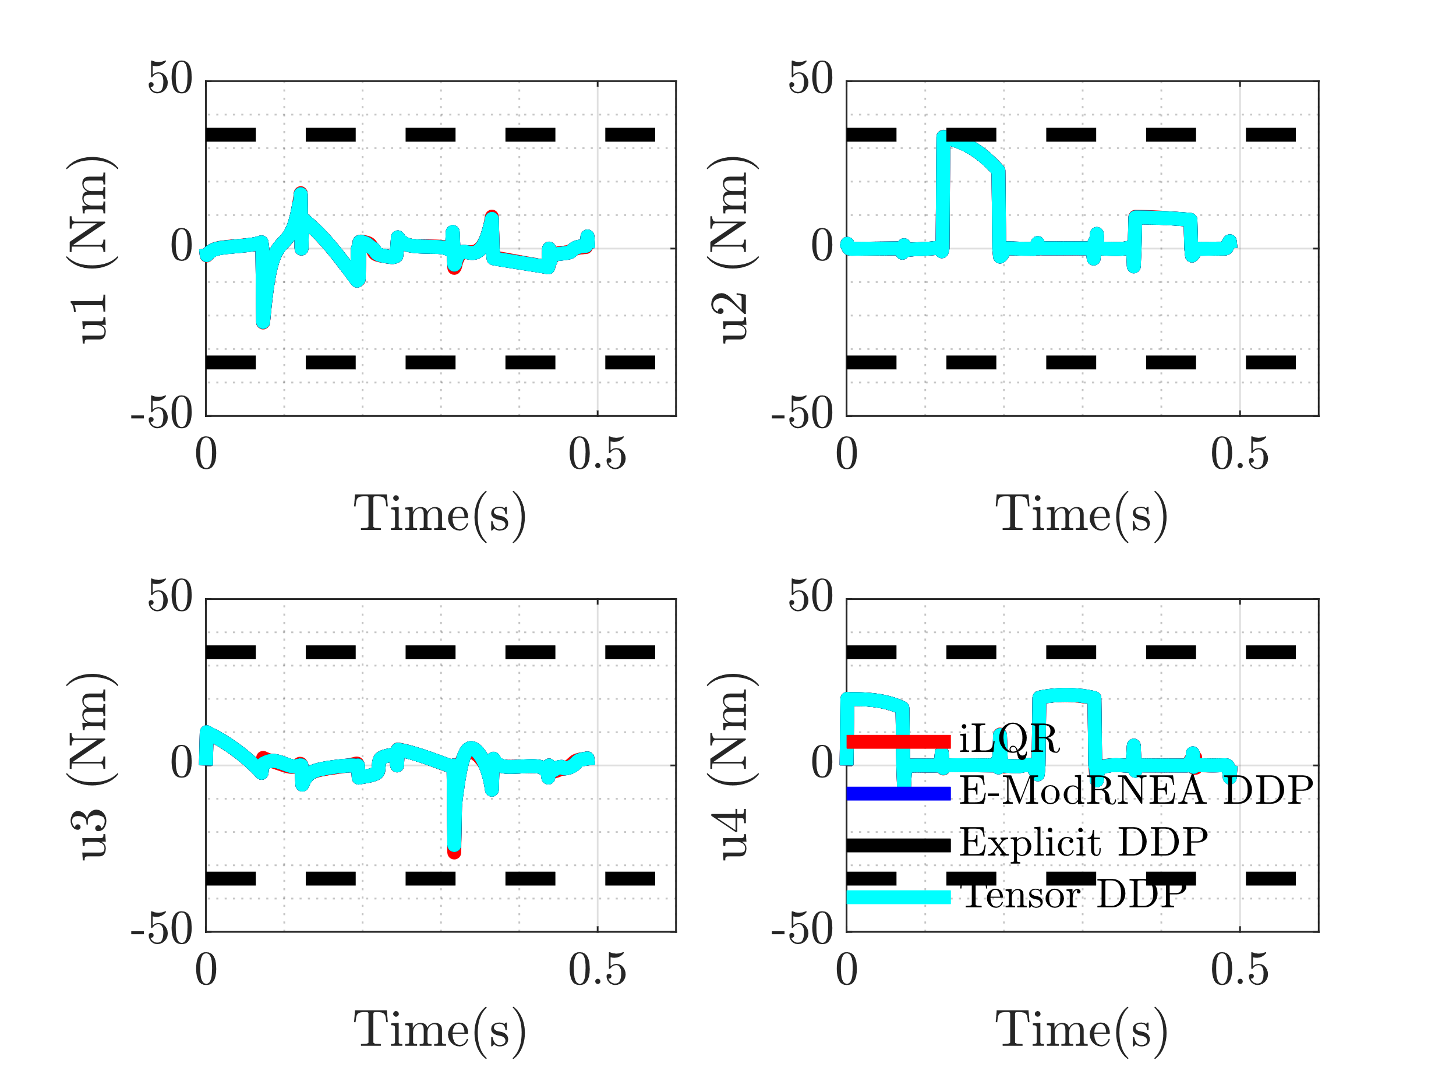
Control

Slide 4
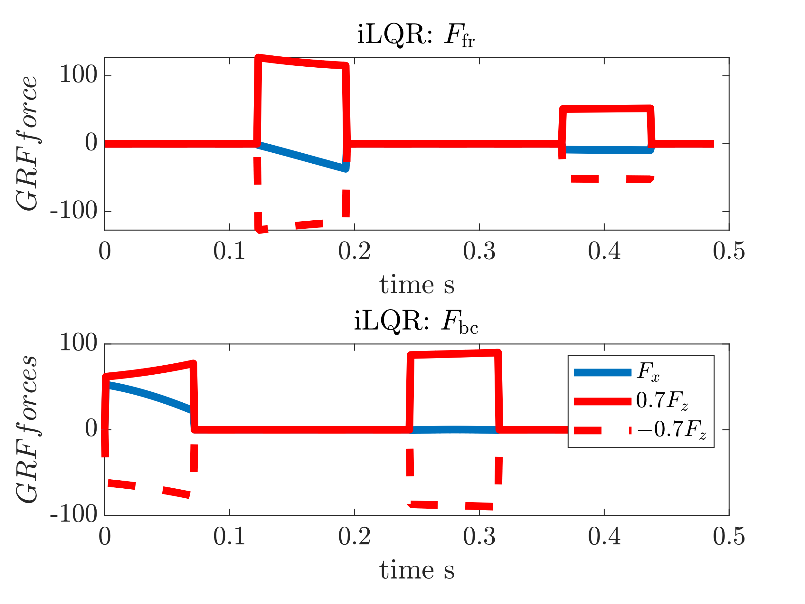

GRFs

Slide 5
Full Run with Noise

Slide 6
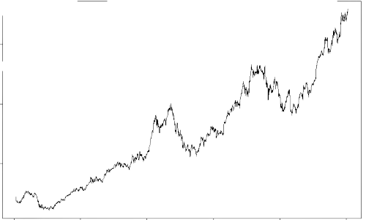
Add Noise to Trajectory
Trajectory
Control
Initial
Intermediate
Optimal
Trajectory
Control
Noise * Large Scalar
Run either iLQR/DDP to convergence

Slide 7
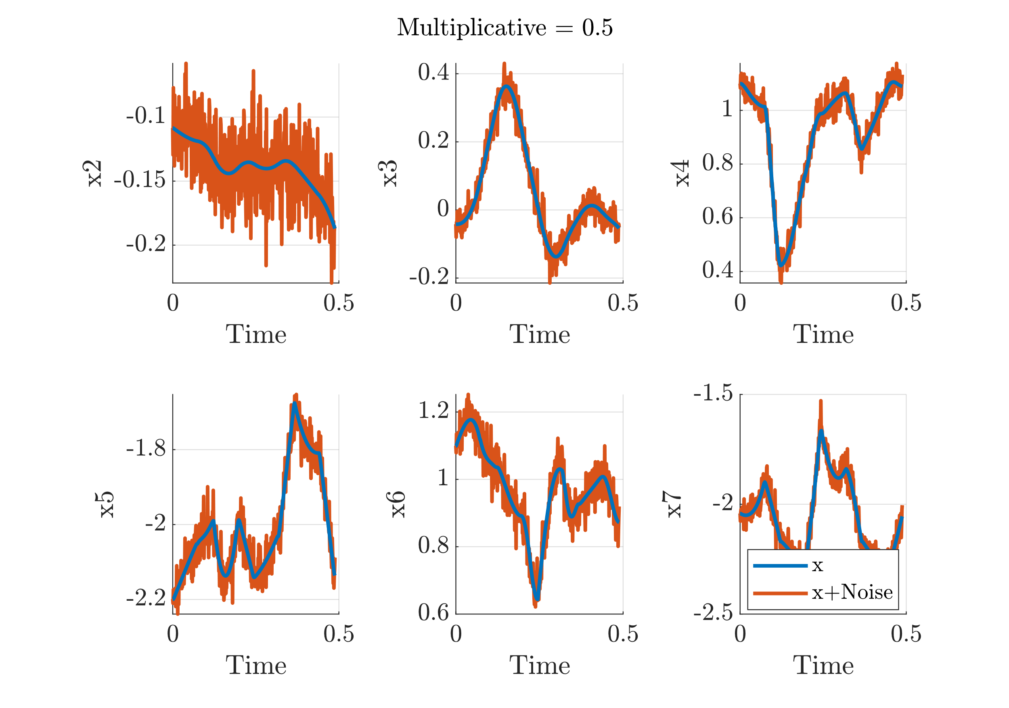
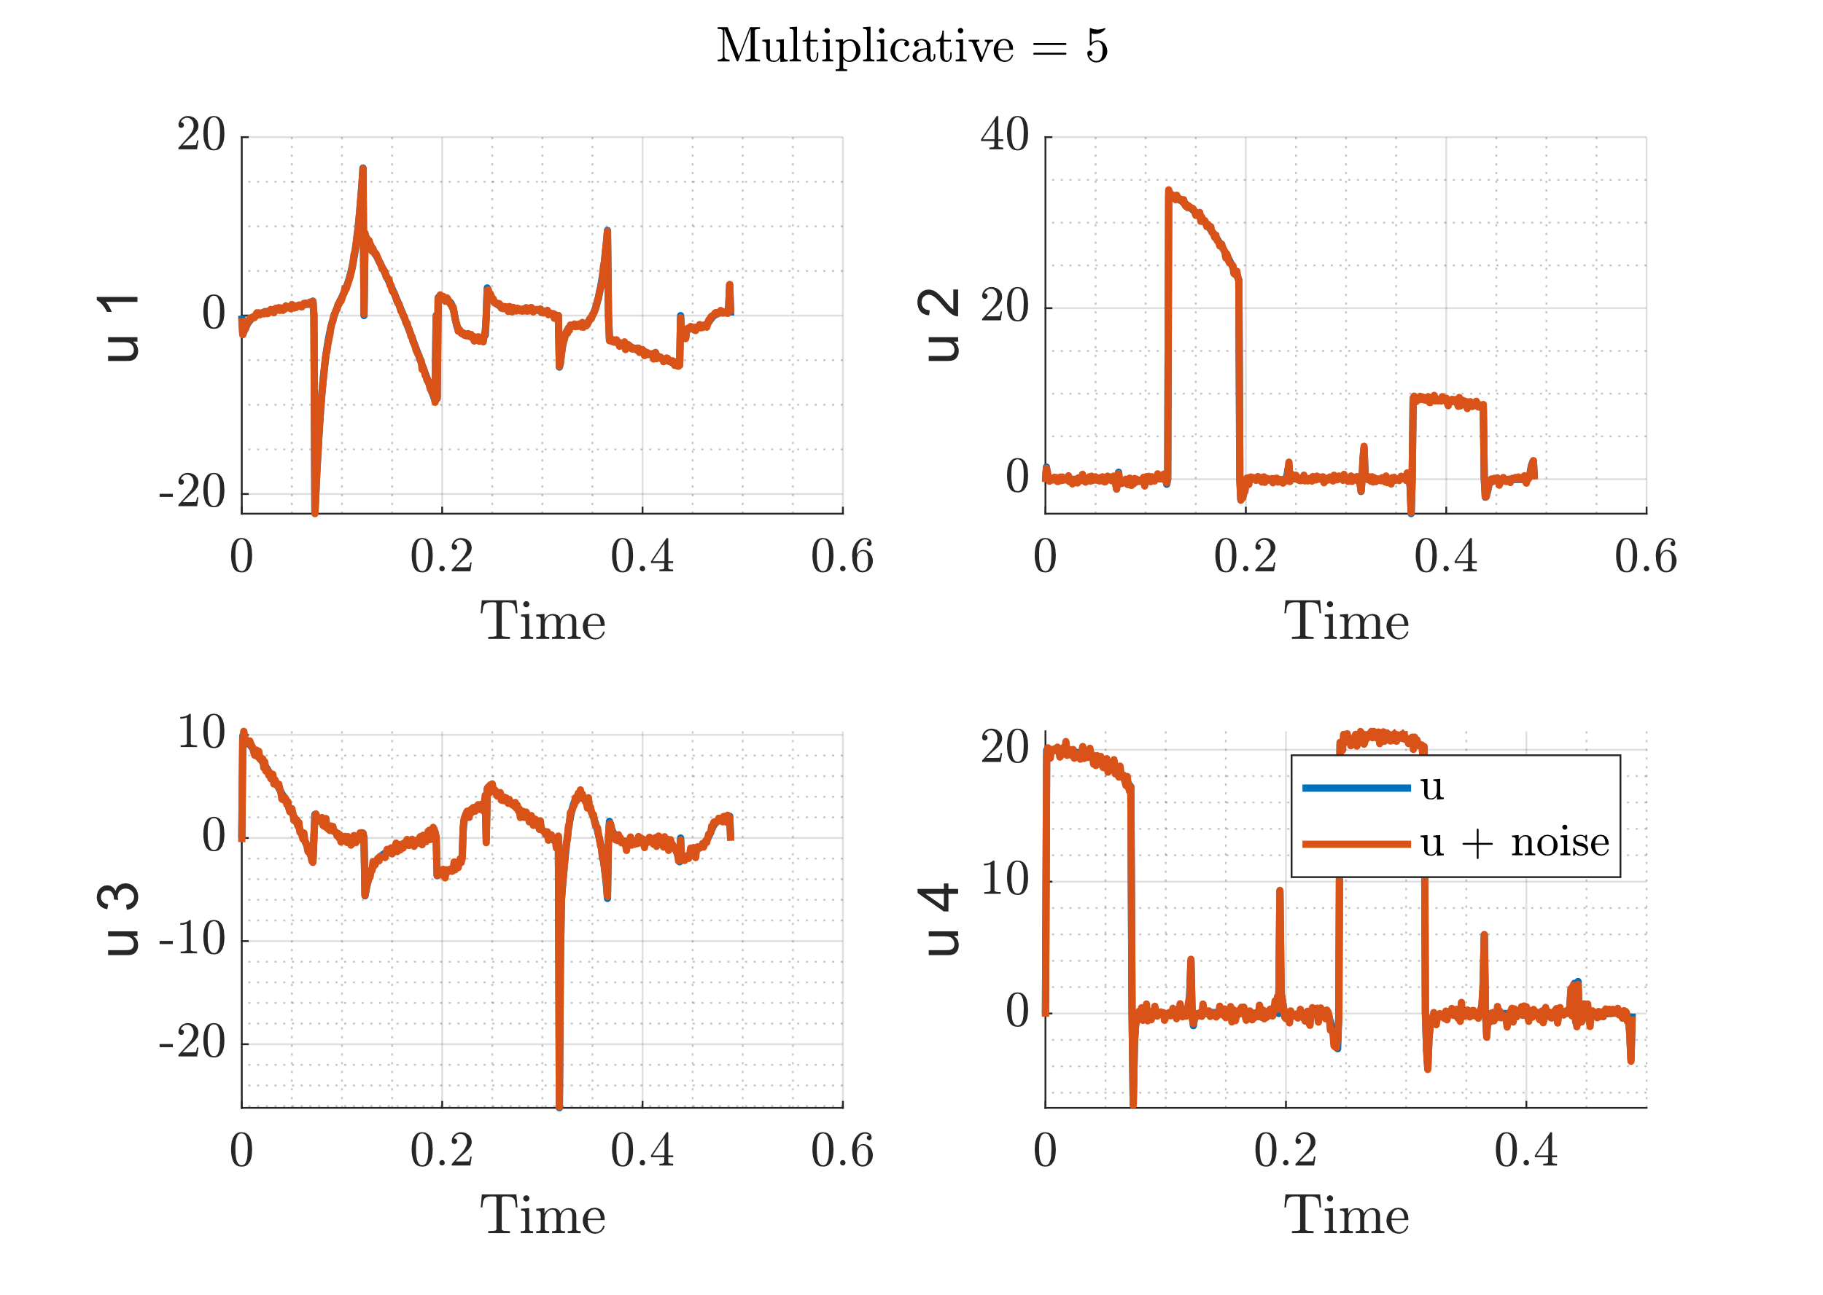
Add Noise Realization
State
Control
More noise on control didn’t lead to good trajectory (motion)

Slide 8
Adding Regularization to iLQR
Cost function

Slide 9

Resulting Motions
iLQR
DDP
Similar motion after noising up state/control and running optimization

Slide 10
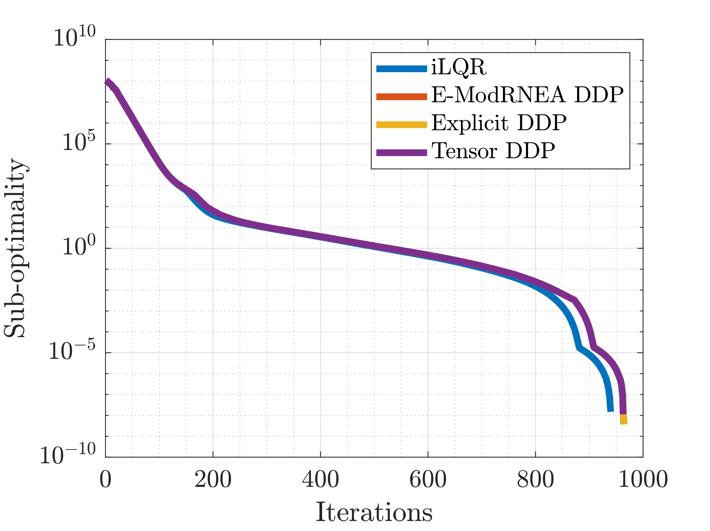
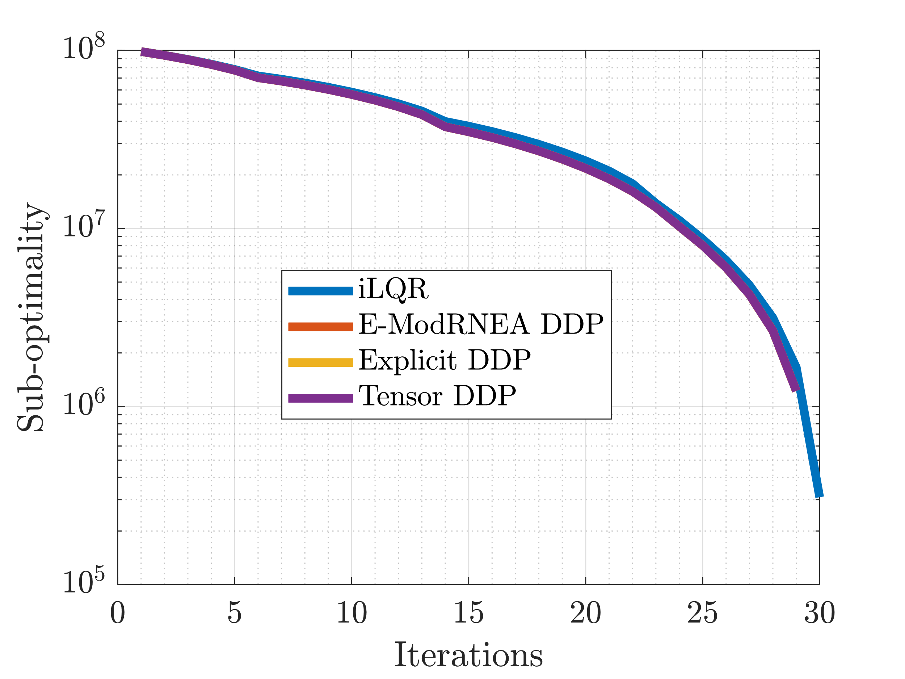
Sub-Optimality
Comparison with self
Comparison with previous optimal
Means it now converged to better trajectory
Benefits of DDP not evident in this noise realization

Slide 11
Convergence plots
Take functions that have linear/quad behavior
Plot their qualitative behavior
Will allow interpretation of other plots

Slide 12
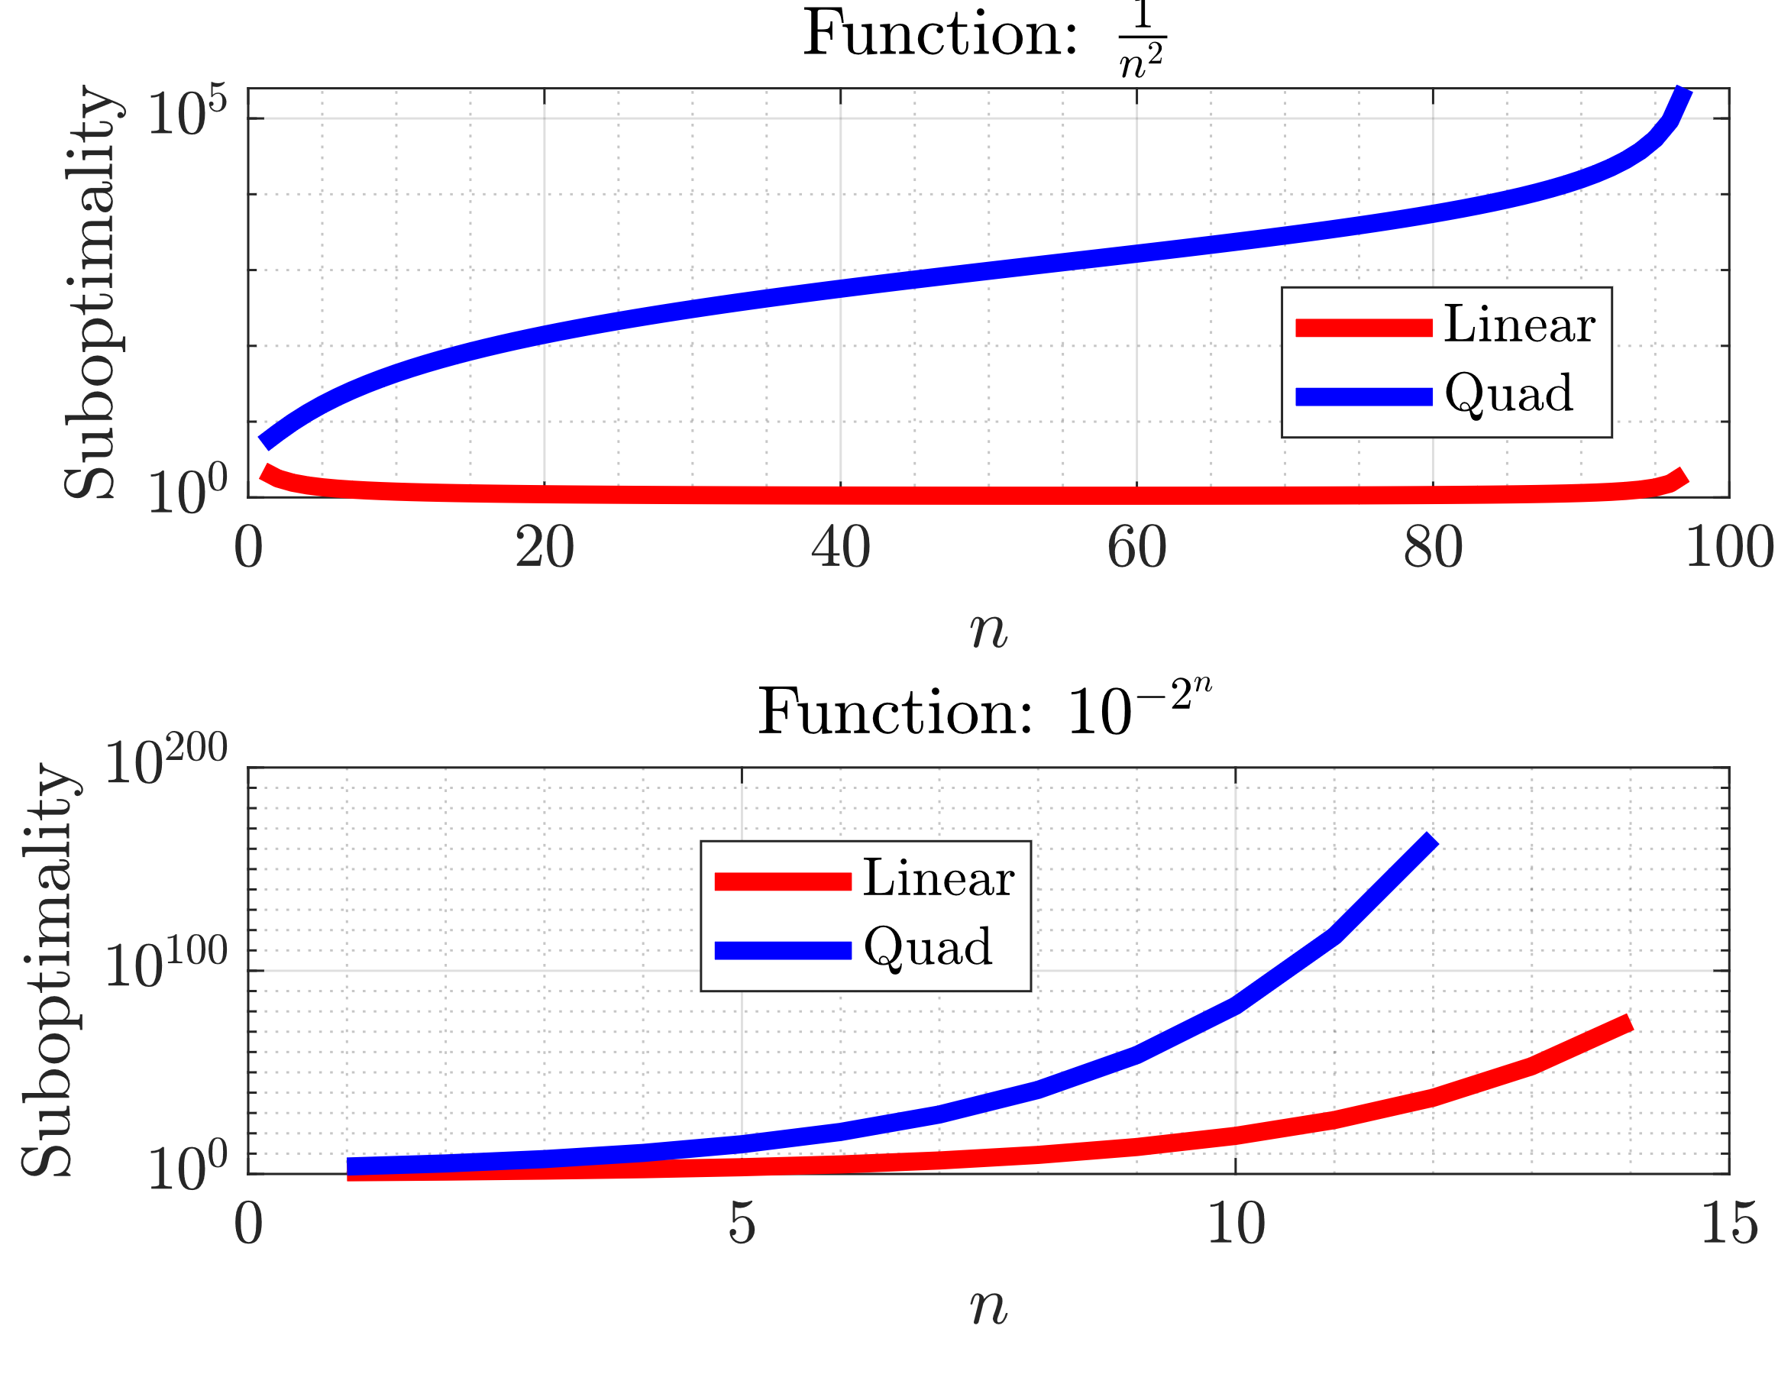
Rates of convergence

Slide 13
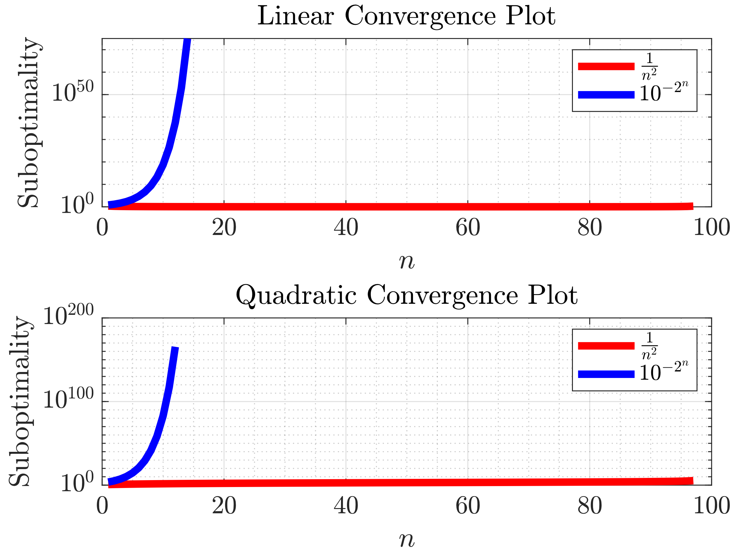
Rates of convergence

Slide 14
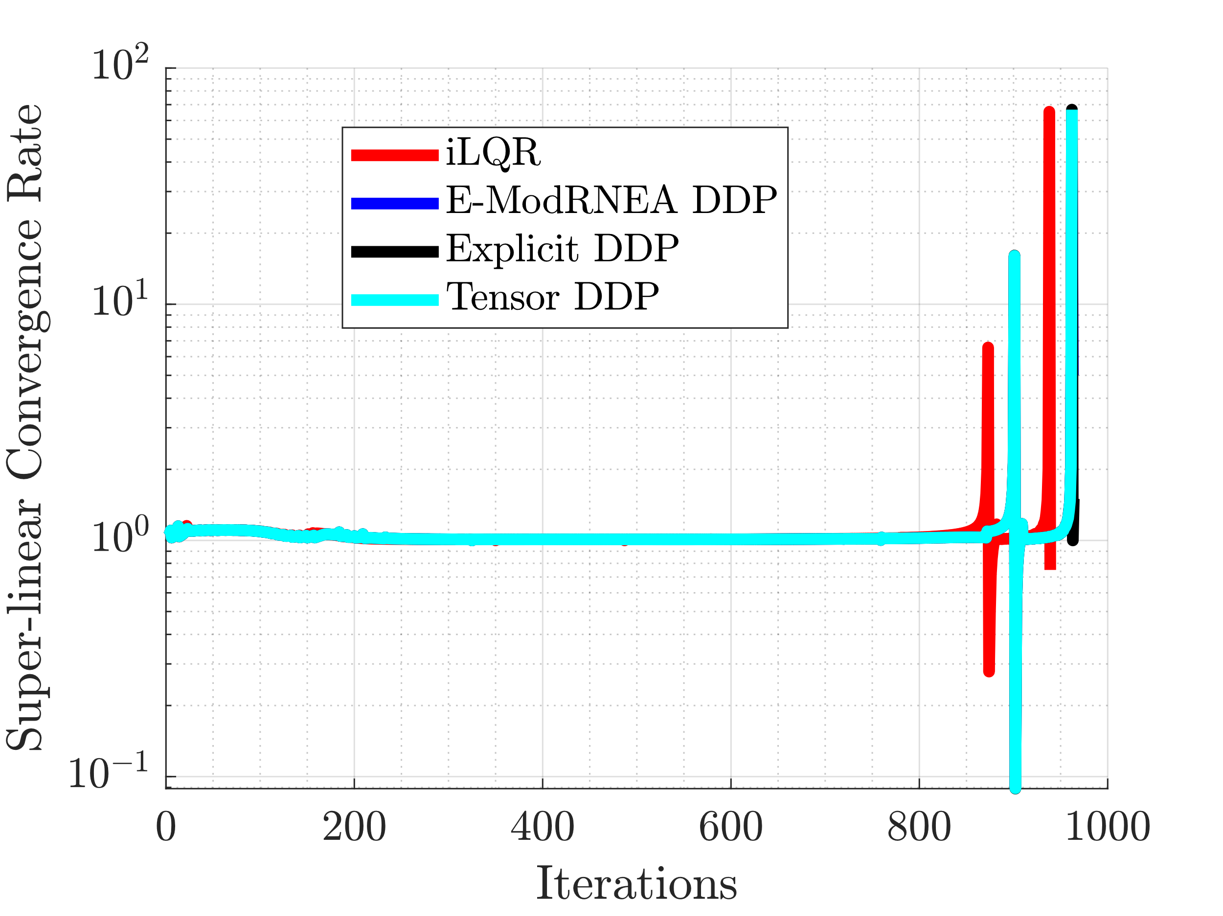
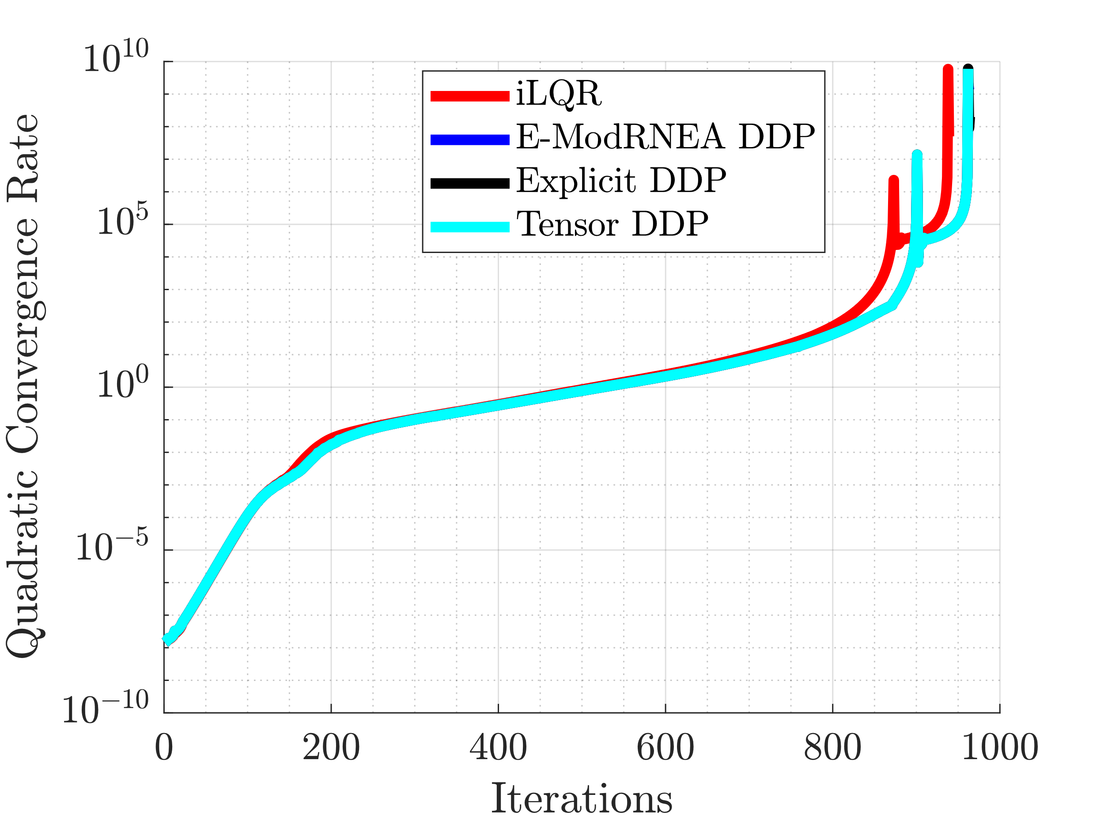
Convergence Rate: Superlinear

Slide 15
Large Control Noise, Zero State Noise
iLQR
DDP
Noise Multiplicative = 50
After running full iLQR/DDP

Slide 16

Noising up State
Adding noise to state
Resulting motion before optimization

Slide 17
Short Run with Noise

Slide 18
Add noise to Optimized Control Trajectory
Use optimized trajectory and control as initial guess
Add weiner noise to controller
Run either iLQR/DDP for 20 iterations
Noise scaling
scaler = linspace(-2,2,15);
N = 585; dt = 1e-3;
dW = sqrt(dt)*randn(4,N); %weiner noise
W = cumsum(dW) * scaler(i);

Slide 19
Add Noise to Trajectory
Trajectory
Control
Initial
Intermediate
Optimal
Control
Trajectory
Noise * Scalar
Run either iLQR/DDP for 20 iterations

Slide 20
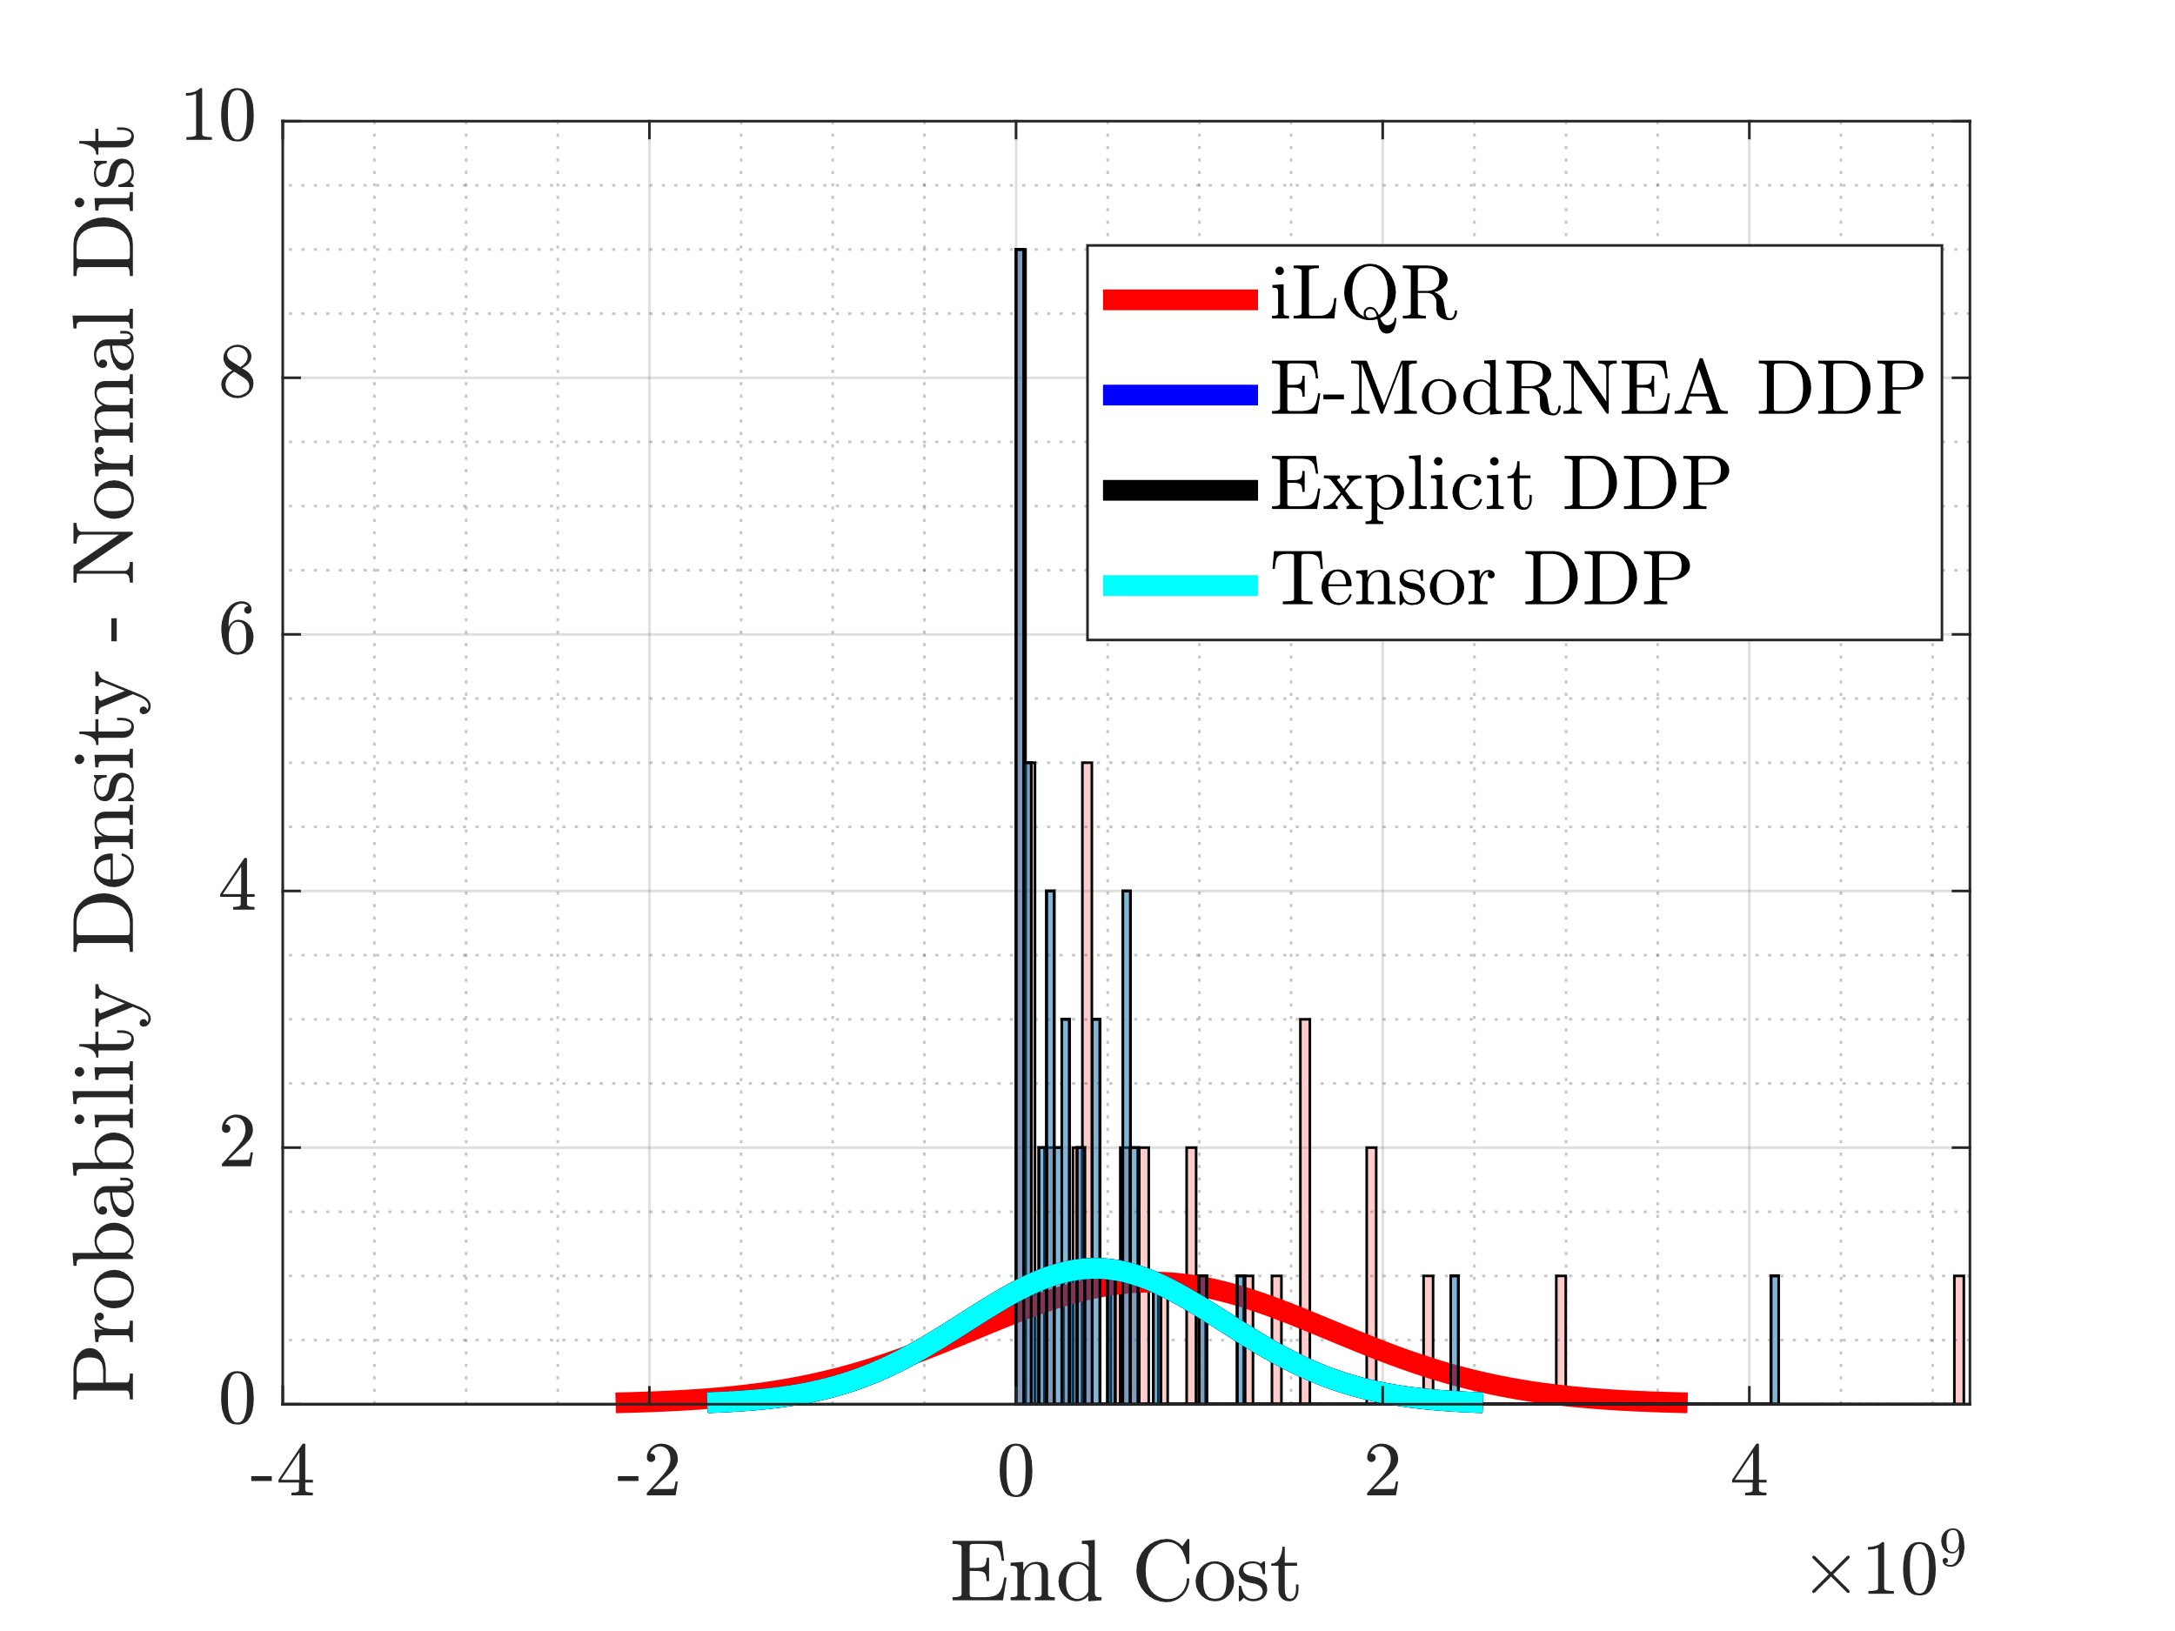
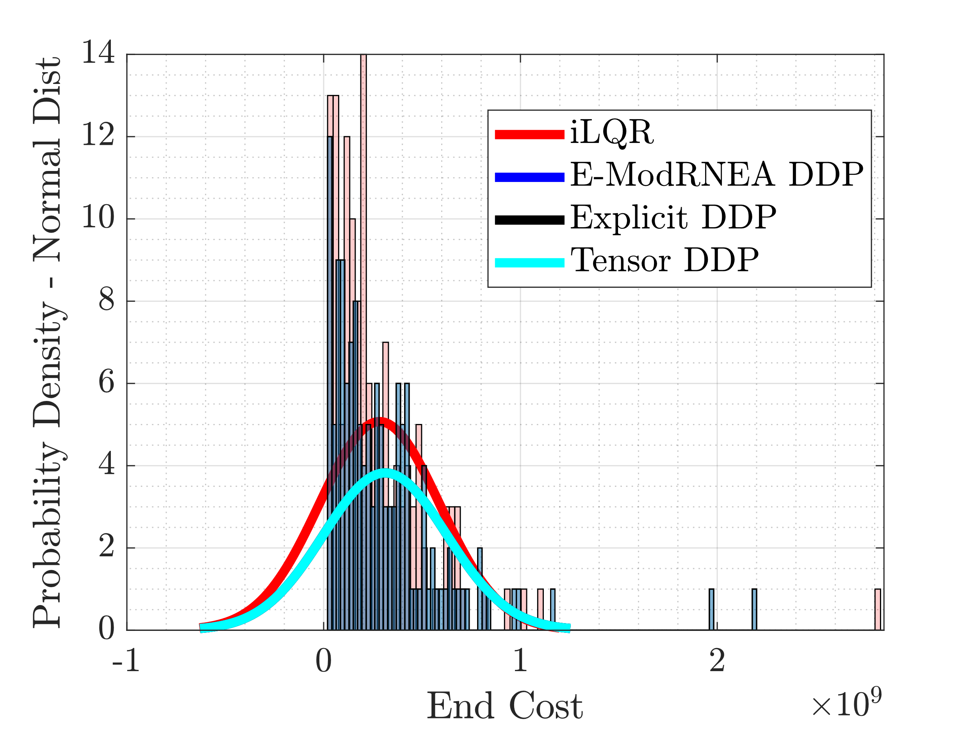
End Cost Distribution
Before adding Regularization to iLQR
Variation only in control tape
Results from last week
After adding Regularization to iLQR
Variation in control/state tape

Slide 21
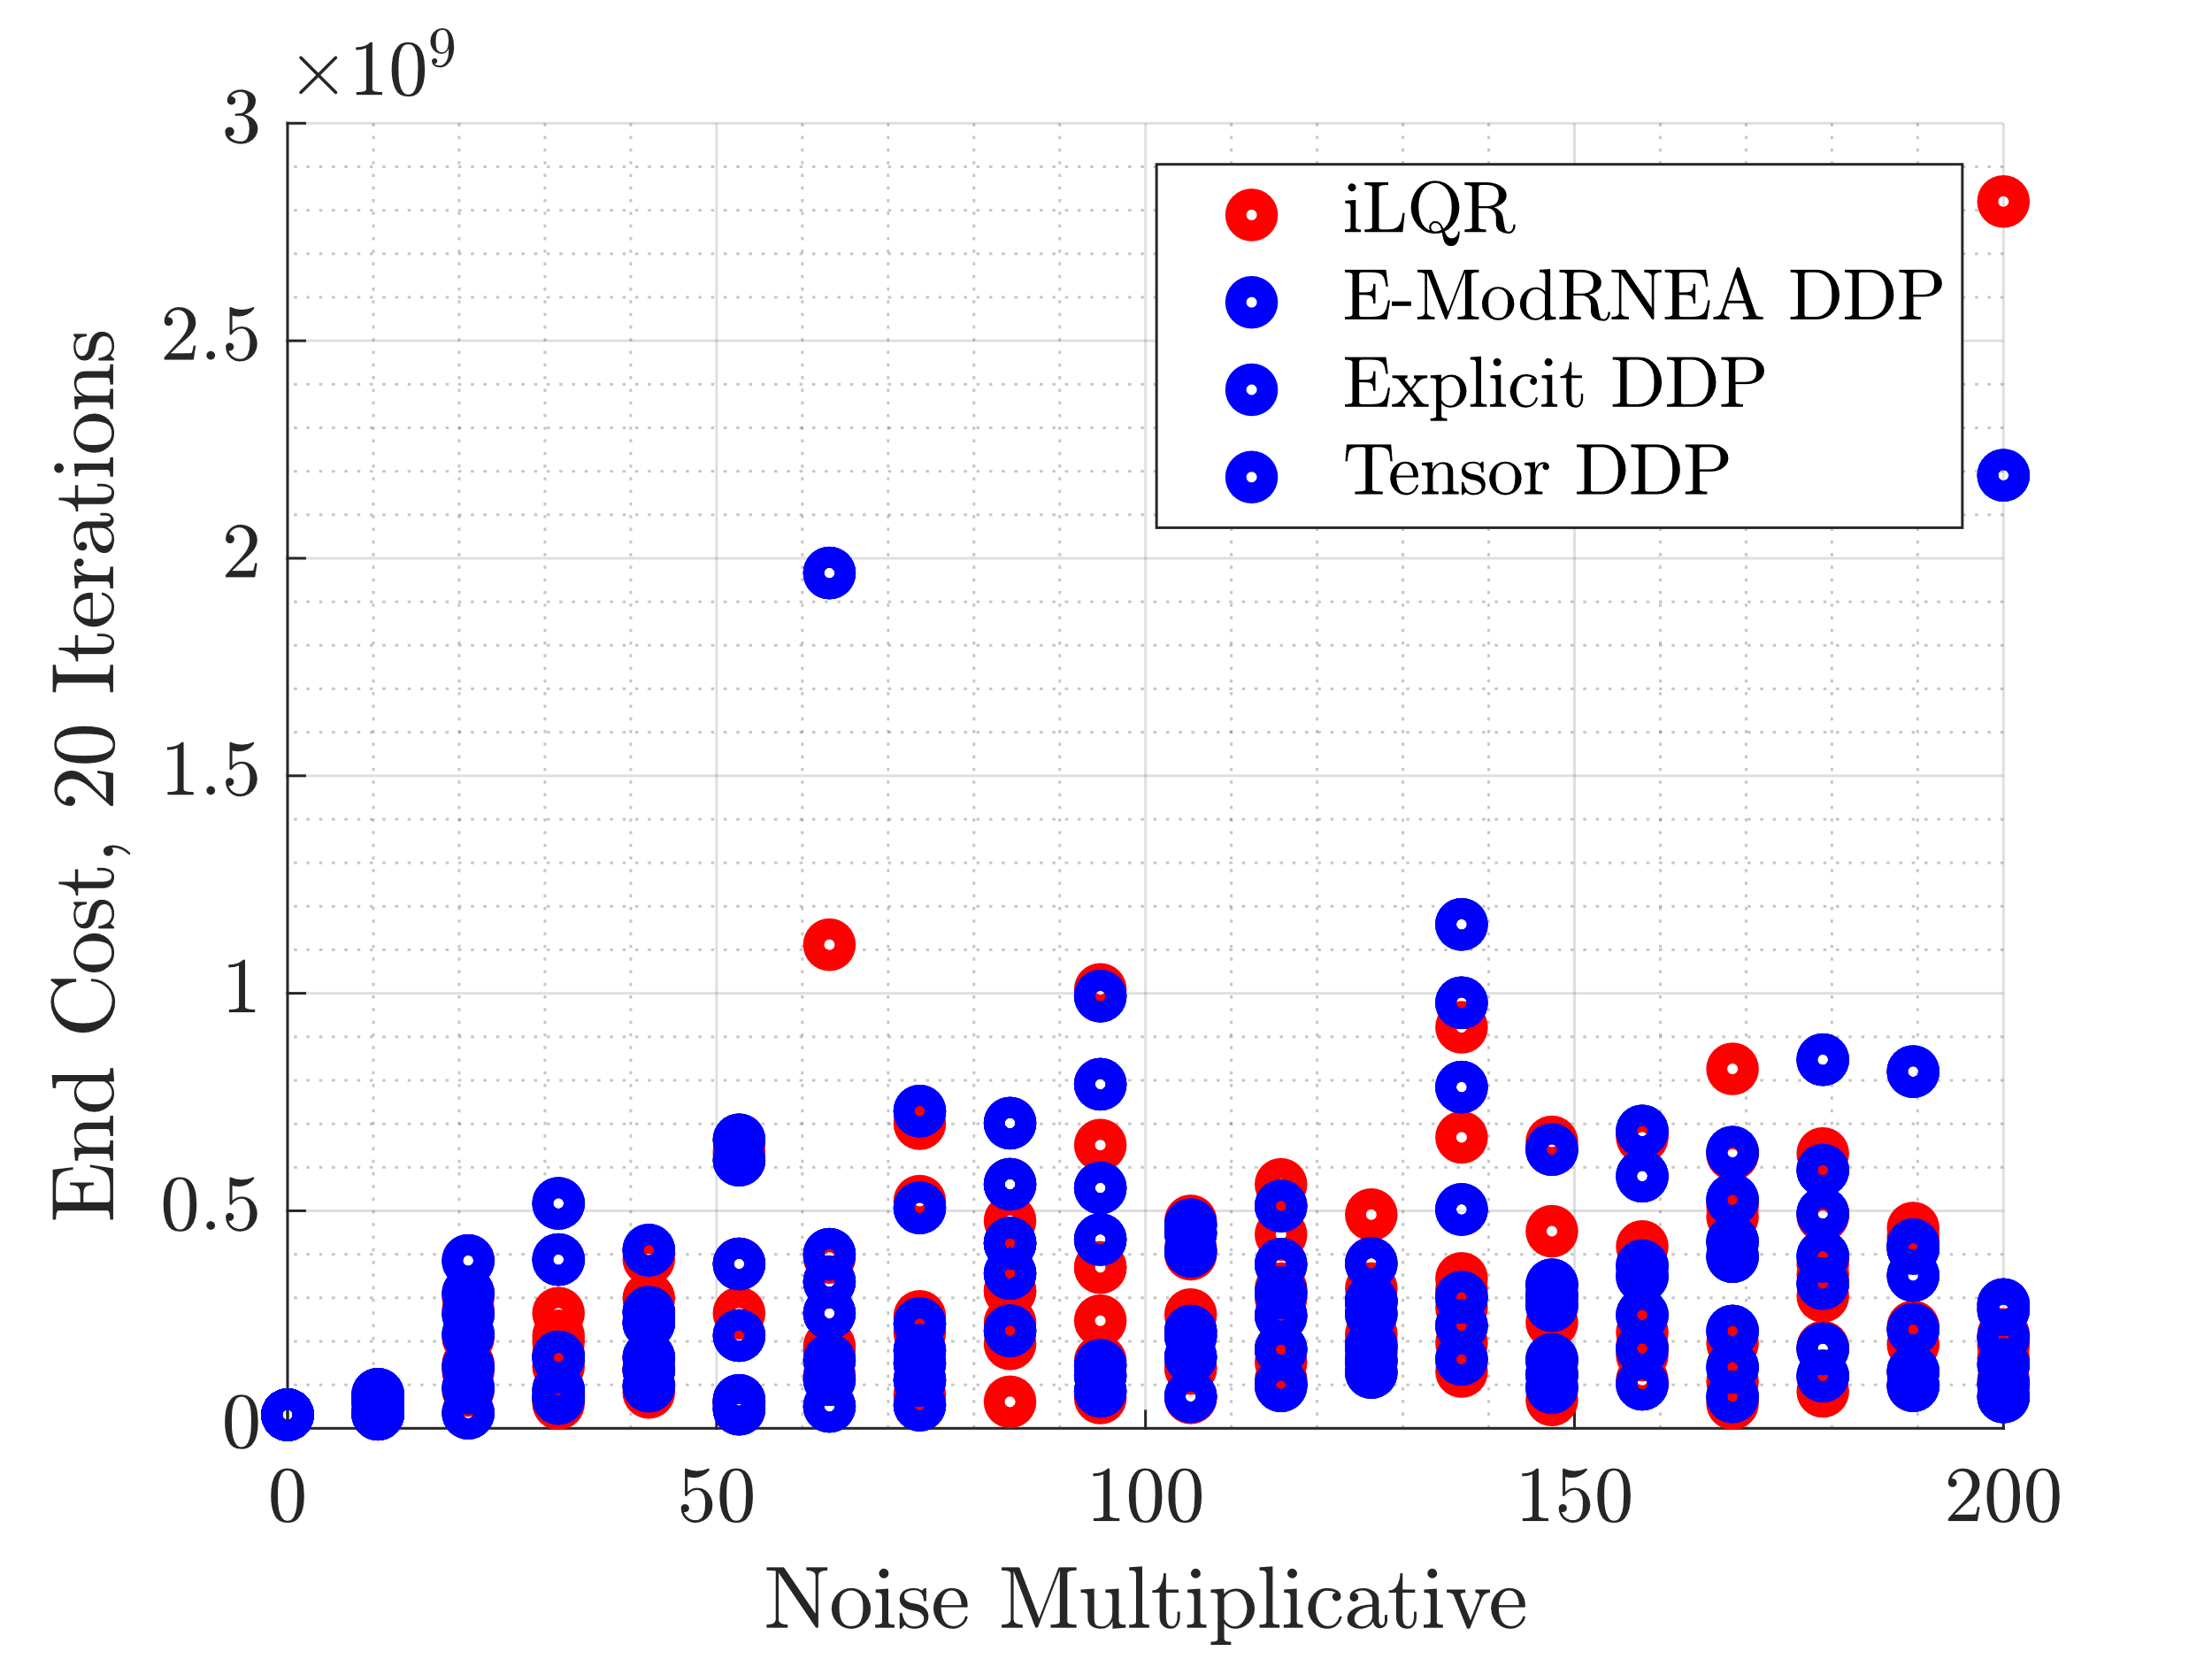
End Cost Distribution
Each Noise Multiplicative had 7 noise realizations

Slide 22
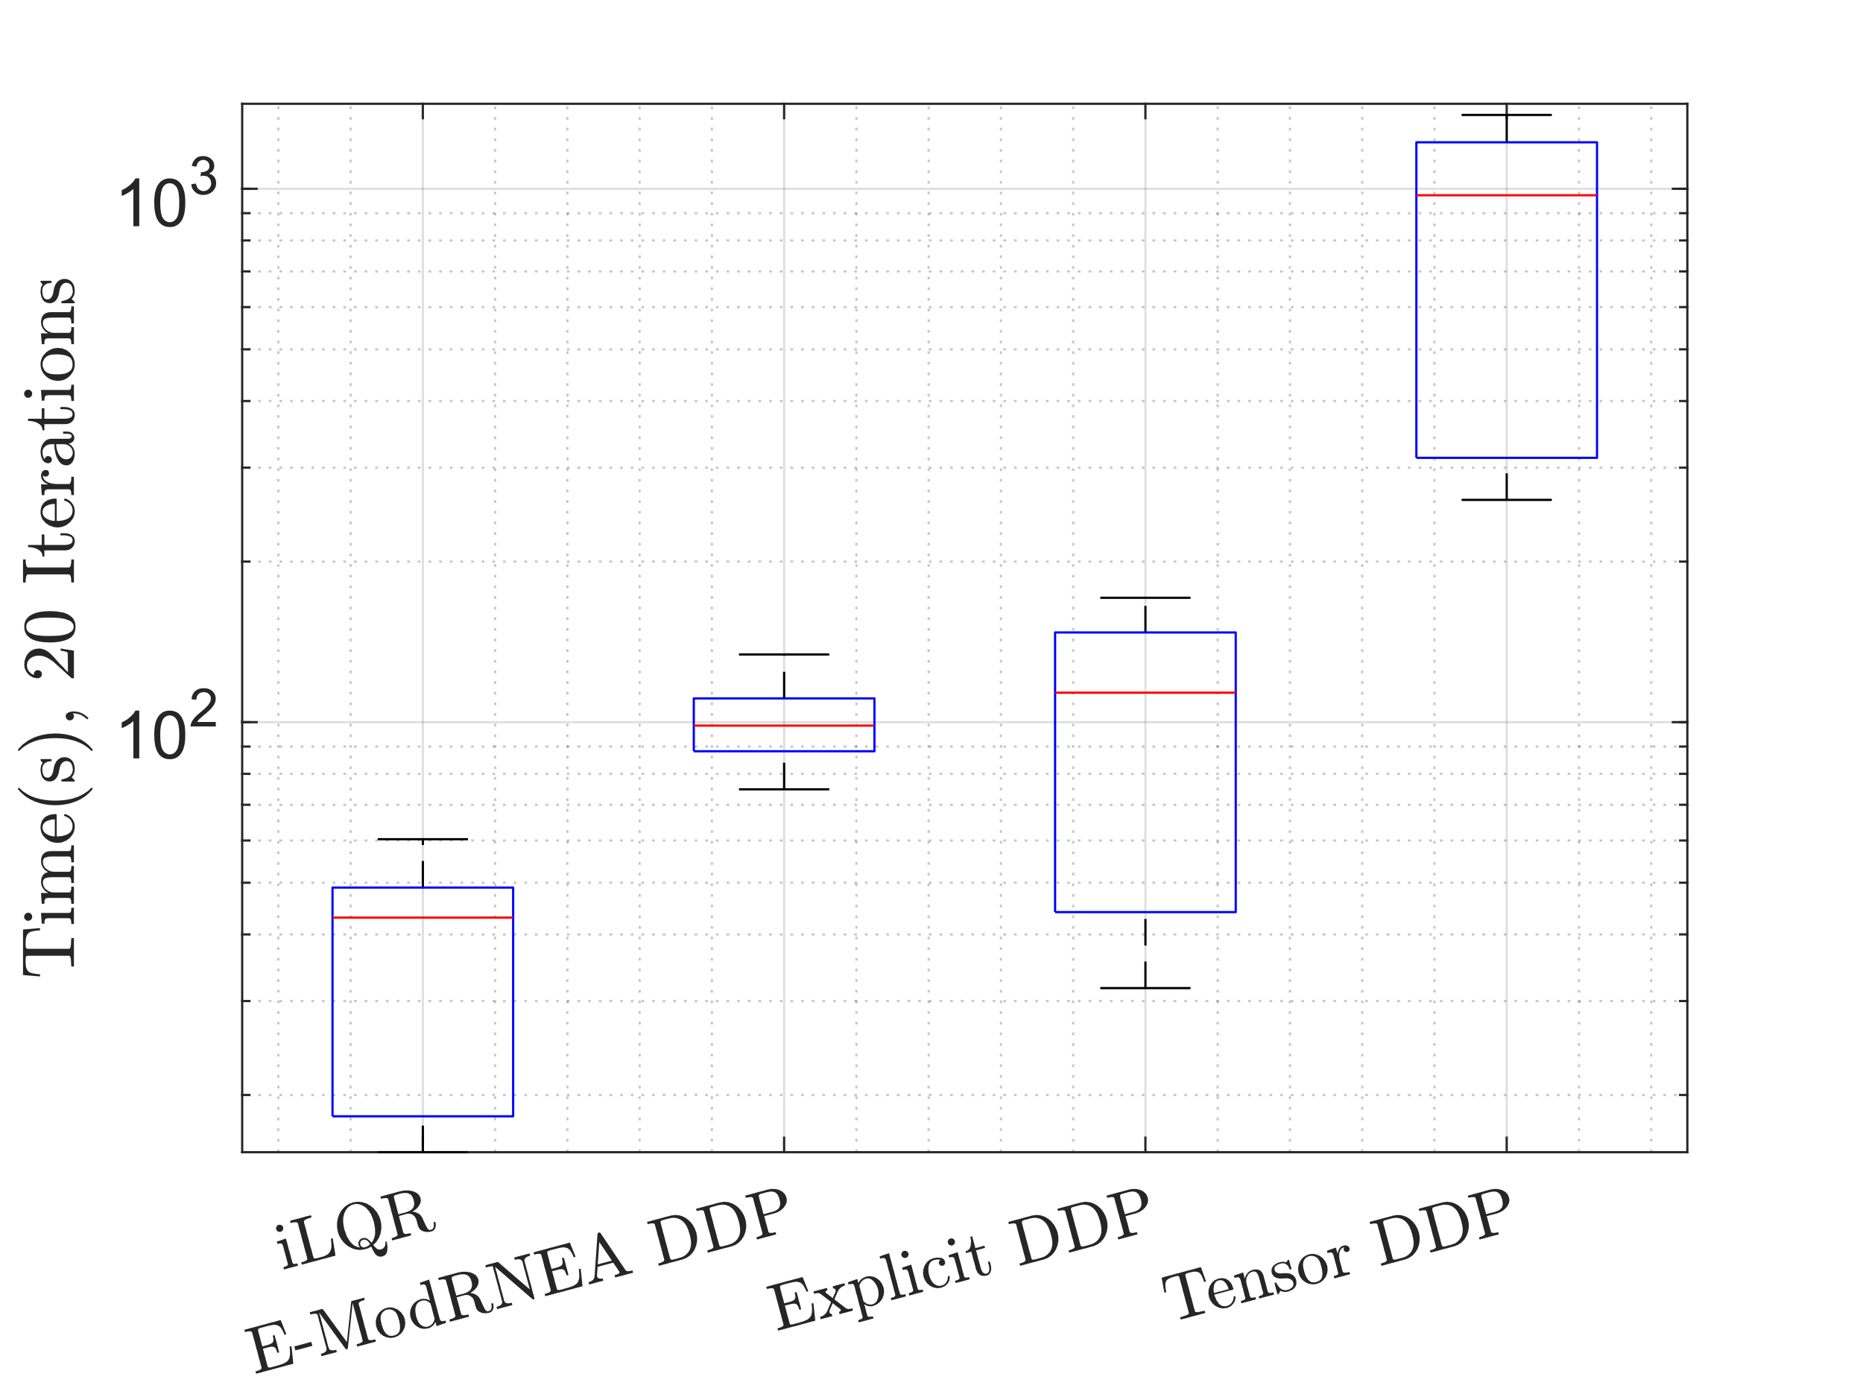
Time

Slide 23
Add noise to control
Use optimized trajectory and control as initial guess
Add weiner noise to controller
Run either iLQR/DDP for 150 iterations
Noise
N = 585; dt = 1e-3;
dW = sqrt(dt)*randn(4,N); %weiner noise
W = cumsum(dW);

